Slide 1
Transparency in Admissions, Higher Education, and Society
Harry Brighouse
University of Wisconsin, Madison
For the CERPP Conference 2020: Reclaiming Public Trust in Admissions and Higher Education

Slide 3
“College places cannot be bought, but can only be earned by merit”

Slide 4
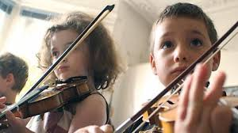
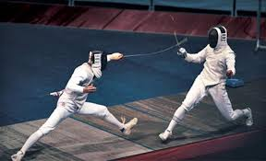
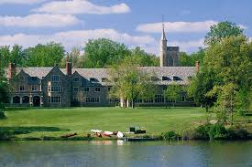

Slide 6
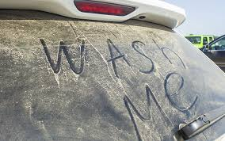

Slide 7
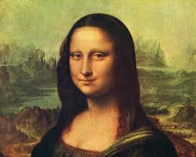

Slide 8
Clarifying the mission
To equip our students optimally to contribute to the public good.

Slide 9
Redefining Merit
Optimal prospective contribution to the public good

Slide 10
Three arenas of opacity
Admissions
Financial Aid
Instructional quality
Notes:
But there are plenty more questions obviously. Questions about tracking and vocational education, about special education provision, about civic education, etc

Slide 11
Transparency, Opacity, Accountability

Slide 12
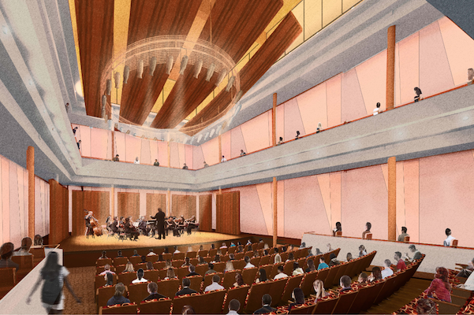
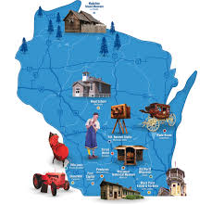
The benefits of opacity

Slide 13
A few infrequently taught languages taught at Madison
Yiddish, Yoruba, Yucatec Maya, Wolof, Vietnamese, Urdu, Turkish, Tibetan, Thai, Swahili, Sanskrit, Quechua, Russian, Polish, Ojibwe, Persian, Korean, Khmer, Kazakh, Hmong, Indonesian, Hausa, Finnish, Czech…..

Slide 14
What is to be done?

