Slide 1
Admissions and Enrollment In Crisis
Donald E. Heller
Provost and Vice President of Academic Affairs Professor of Education University of San Francisco
January, 27, 2020

Slide 2
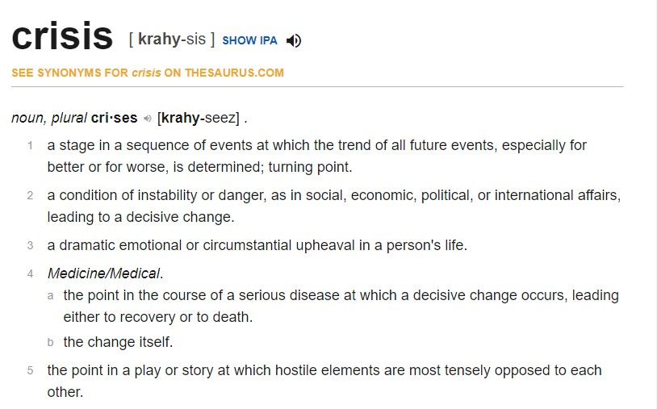

Slide 3
What factors have led to the crisis?
Uninterrupted increases in sticker prices
Concerns about student debt
Questions about the value of a college degree
Criticisms of universities and students: Political correctness, snowflake students, sexual assaults, poor outcomes, etc.
The entire admissions maelstrom
Affirmative action
Legacy admissions
Rigged system
Varsity Blues

Slide 4
What do we need to do?
Tell our stories better – about prices
Private sticker
(+88%)
Discount 45%
Private net
(+32%)
Discount 22%
Public sticker
(+120%)
Discount 30%
Public net
(+83%)
Discount 16%
College Board, Trends in College Pricing 2019

Slide 5
What do we need to do?
Tell our stories better – about debt
What are real debt burdens, not the sensationalized numbers
Who is defaulting
What borrower protections are available

Slide 6
What do we need to do?
Tell our stories better – about the value of a degree
BA &
higher
BA
only
% of workers with: | 2000 | 2019
At least some college | 58% | 68%
BA or higher | 31% | 41%
Some
college
or AA
Bureau of Labor Statistics, CPS median weekly earnings age 25+

Slide 7
What do we need to do?
Help students make better decisions
In choosing a college
In financing their education, including appropriate borrowing
In making good decisions once enrolled
Get our own houses in order
Better align our enrollment management practices and policies with our missions
Examine practices and policies that lead to perceptions of a rigged system
Communicate concrete steps being taken

Slide 8
Questions and discussion

